Slide 1
Glue DataQuality

Slide 2
AWS Glue DataQuality Features & Benefits
Data Quality Recommendations (Data at rest)
Data Quality Rules customization and actions
- alerting
- stopping job and prevent bad data from getting into data lake
Data Quality Definition Language (DQDL)
- easy to write and read
Data Quality at rest (Data Catalog) + Data Quality in transit (ETL)

Slide 3
Limitation
Data quality rules can't evaluate nested or list-type data sources.

Slide 4
Data Quality At Rest
Select Dataset in Glue Data Catalog
Glue DataQuality analyze and recommend rules
Refine rules to create finalized rules
Glue DataQuality evaluate rules against dataset
Reviews result and alerts
Create Rules by yourself

Slide 5
Data at Rest
Use Cases:
Perform data quality checks on datasets that is already cataloged in AWS data catalog
Identify or evaluate data quality issues in data lake on an ongoing basis

Slide 6
Data Quality in Transit
Select an ETL Job and add Data Quality rules and action
Glue DataQuality evaluate rules
Receive alerts and results
Data in Transit
Data at rest
Pass
S3
(Cleaned)
Glue Job
DataQuality Check
Pass
Glue Job
Source
S3
(Raw)
DataQuality Check
Fail
Send Notification
STOP
Fail

Slide 7
Data in Transit
Use Cases:
-Incorporate data quality tasks in ETL jobs
-want to write code that defines data quality tasks in ETL scripts
-manage the quality of data that flows in visual data pipeline

Slide 8
Feature | Data quality for the Data Catalog | Data quality for ETL jobs
Data sources | Amazon S3, Amazon Redshift, JDBC sources compatible with the Data Catalog, and transactional data lake formats such as Apache Iceberg, Apache Hudi, and Delta Lake. | All data sources supported by AWS Glue, including custom connectors and third-party connectors.
Data Quality rule recommendations (not important in my opinion) | Supported | Not supported
Author and run DQDL rules | Supported | Supported
Auto scaling | Not supported | Supported
AWS Glue Flex support | Not supported | Supported
Scheduling | Supported when evaluating Data Quality rules and via Step Functions. | Supported when using Step Functions and workflows.
Identifying records that failed data quality checks | Not supported (More of a overview) | Supported (Run queries after adding DQ results to column)
Integration with Amazon Eventbridge | Supported | Supported
Integration with AWS Cloudwatch (Set Alerts) | Supported | Supported
Writing data quality results to Amazon S3 | Supported | Supported
Incremental data quality | Supported via pushdown predicates | Supported via AWS Glue bookmarks
AWS CloudFormation support | Supported | Supported

Slide 9
Data Rules
AggregateMatch Checks if aggregate measures of two columns match. This rule supports comparing two datasets and is useful to test if two datasets are in synch using aggregate measures | DatasetMatch Checks the percentage of records in the primary dataset that are equal to records in the reference dataset by joining the datasets using a primary/composite key | ColumnCorrelation Check the correlation between two given columns | ColumnDataType Check the data type of the given column | ColumnExists Check the existence of a given column
ColumnNamesMatchPattern Checks if the names of the columns in the dataset match a given pattern | ColumnValues Checks if the specified column have values that are provided. This rule supports dates, regular expressions, strings, numeric values. | Completeness Check the percentage of complete (non-null) values in a given column | Entropy Check the entropy of all values in a given column | ColumnLength Check the length of values of a given column
CustomSql Runs a custom SQL against the dataset and returns a single value | DataFreshness Check the freshness of a date column | ColumnCount Checks the number of columns in the dataset | RowCount Check the number of rows in the dataset | Mean Check the mean (average) of all values in a given column

Slide 10
Data Rules
IsComplete Check if all values in a given column are complete (non-null) | DistinctValuesCount Check the number of distinct values in a given column | IsPrimaryKey Check if a given column contains a primary key, by checking for uniqueness and completeness | IsUnique Check if all values in a given column are unique
ReferentialIntegrity Checks if data in primary dataset is present in the reference dataset | RowCountMatch Checks the percentage match of the row count of the primary dataset against a reference dataset | SchemaMatch Checks if schema matches with the reference dataset | StandardDeviation Check the standard deviation of all values in a given column
UniqueValueRatio Check the ratio of unique values in a given column | Uniqueness Check the percentage of unique values in a given column | Sum Check the sum of all values in a given column

Slide 11
Glue DataQuality from Glue Catalog

Slide 12
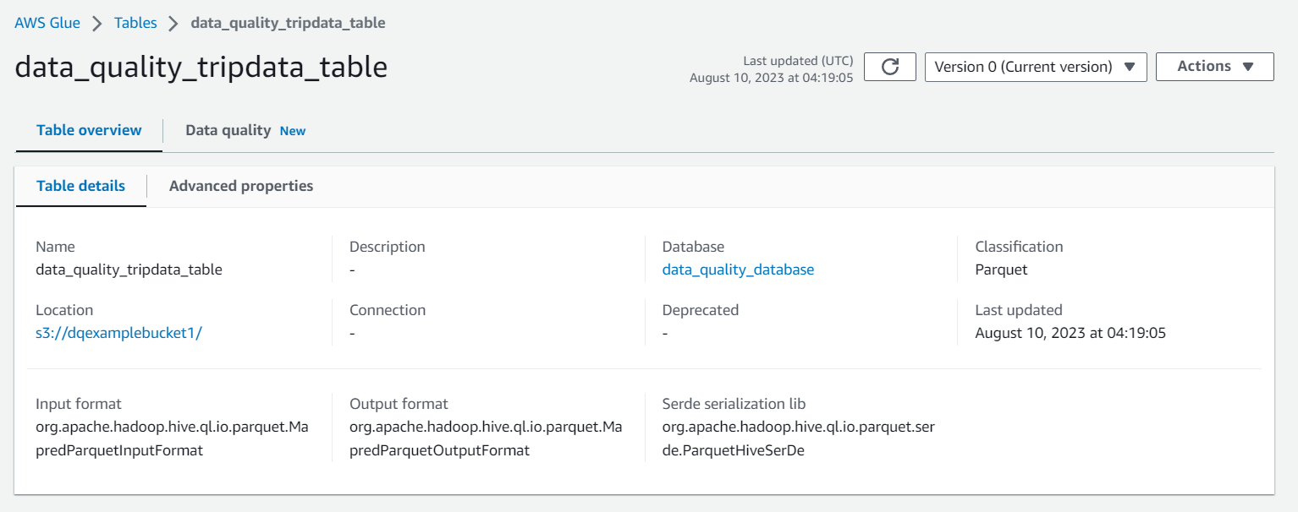
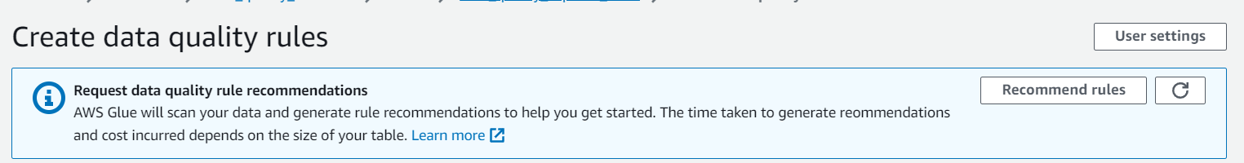
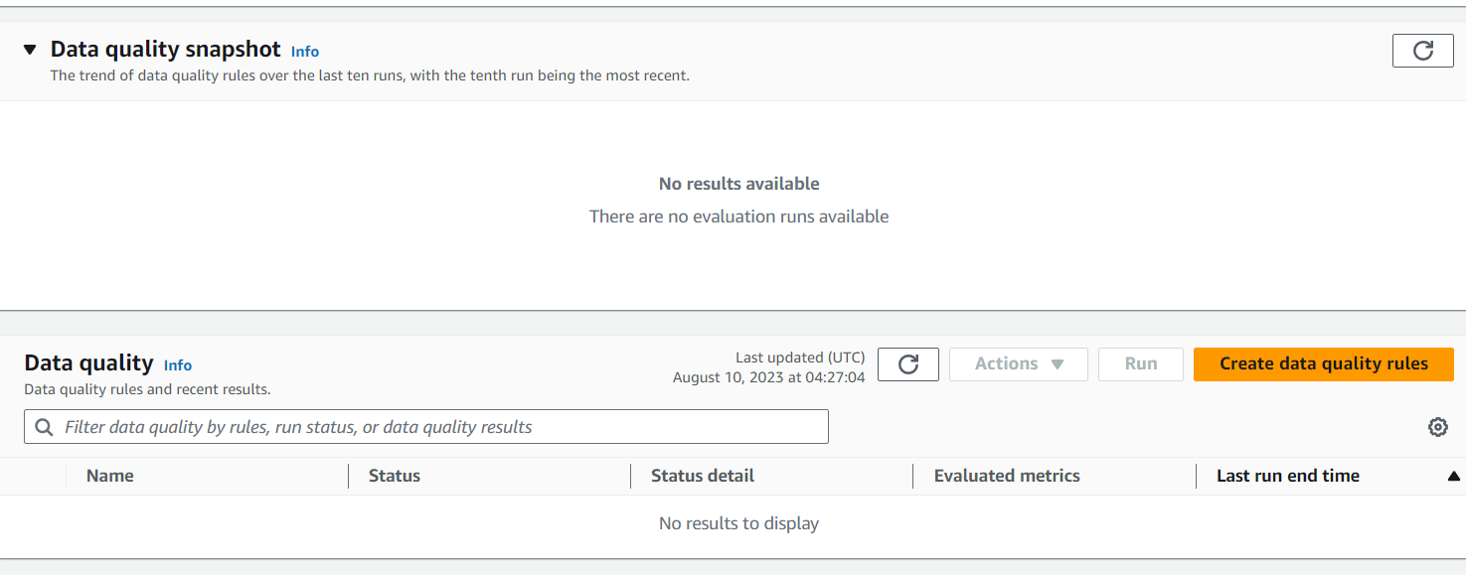
Manually created a schema in Glue without crawler

Slide 13
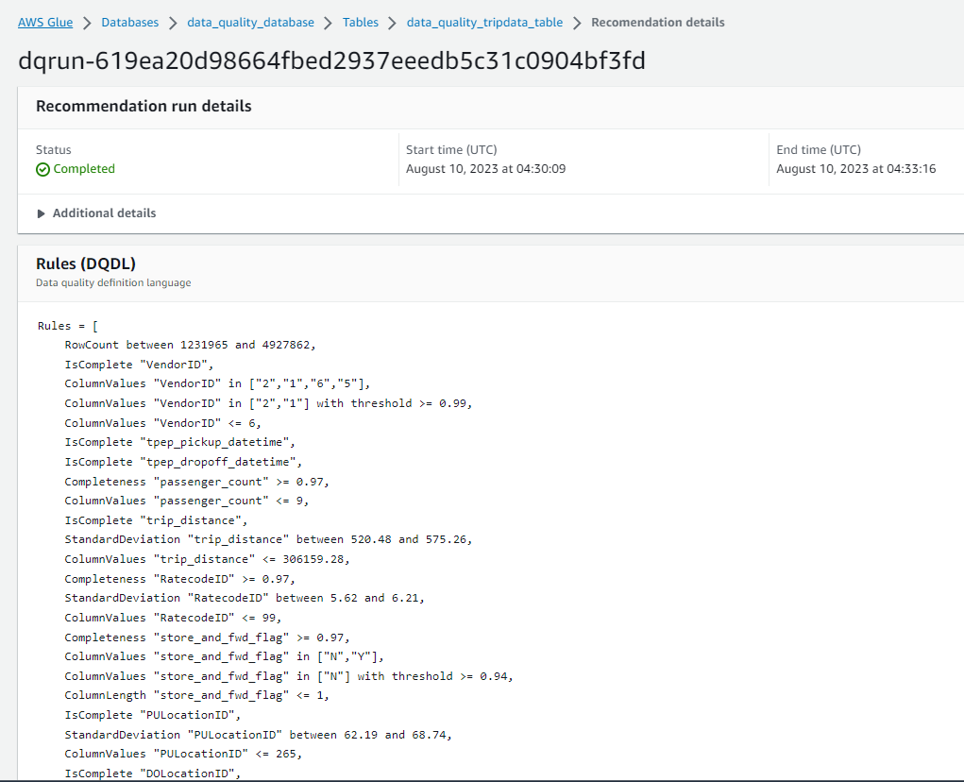
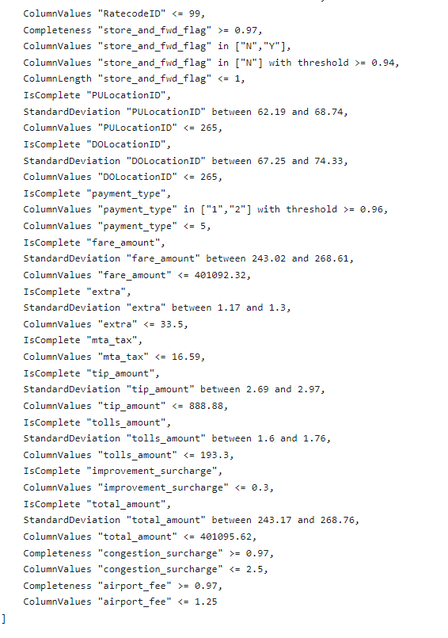
Sure-pass DQ run
Recommended based on given database
Not all are useful
To edit from here

Slide 14
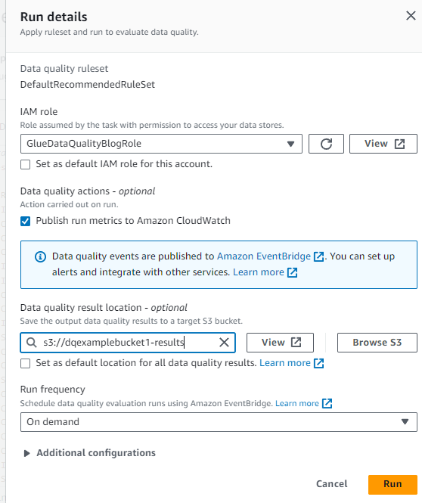
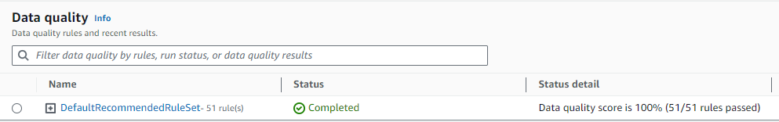
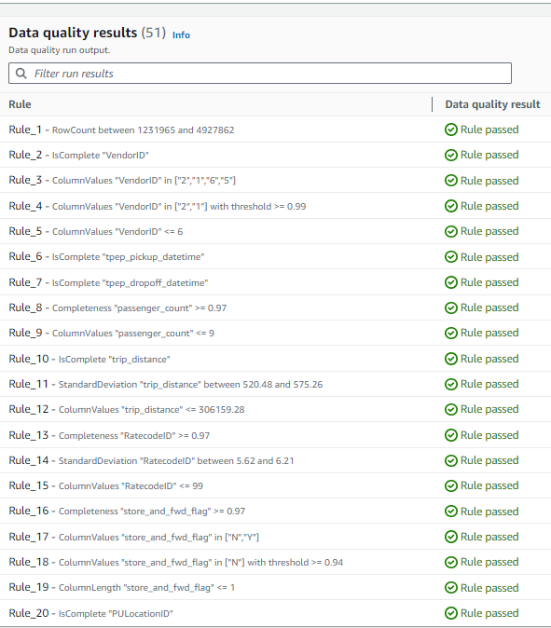

Slide 15
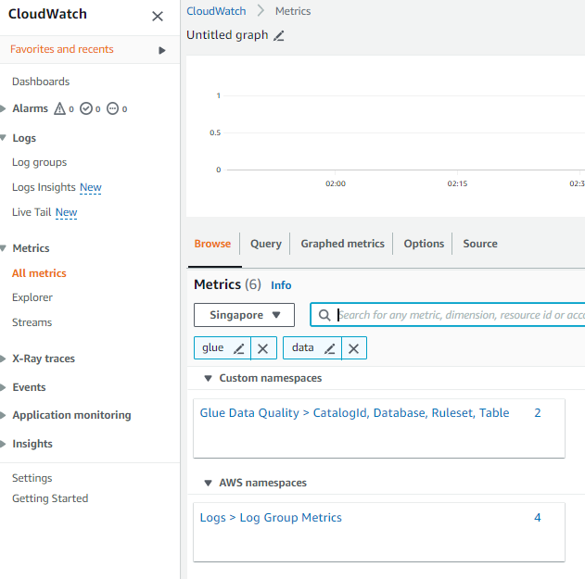
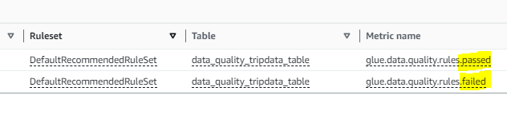
Linked to CloudWatch and Alerts
-Able to create metrics based on ruleset outcome

Slide 16
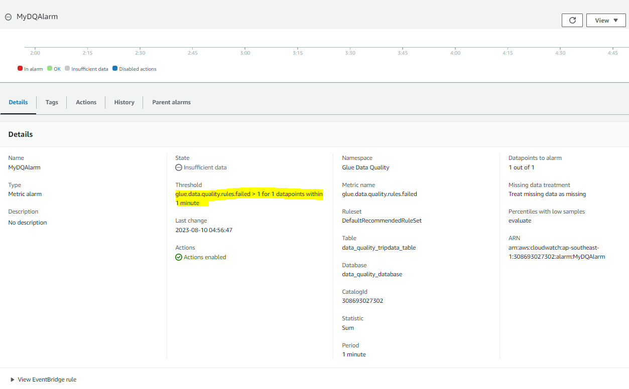

Slide 17
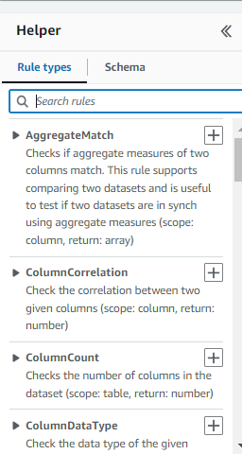
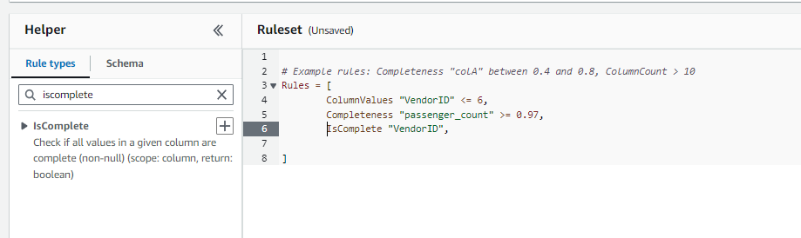
Creating Ruleset

Slide 18
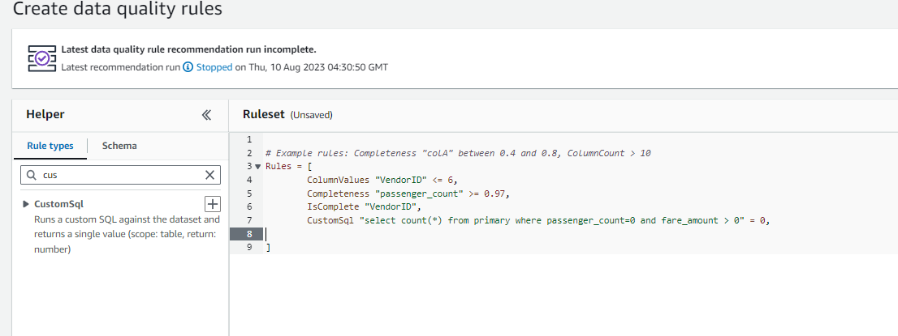
Creating a fail rule
CustomSQL.
By right if there is no passenger_count, there should be no fare, so fare amount cannot be > 0.

Slide 19
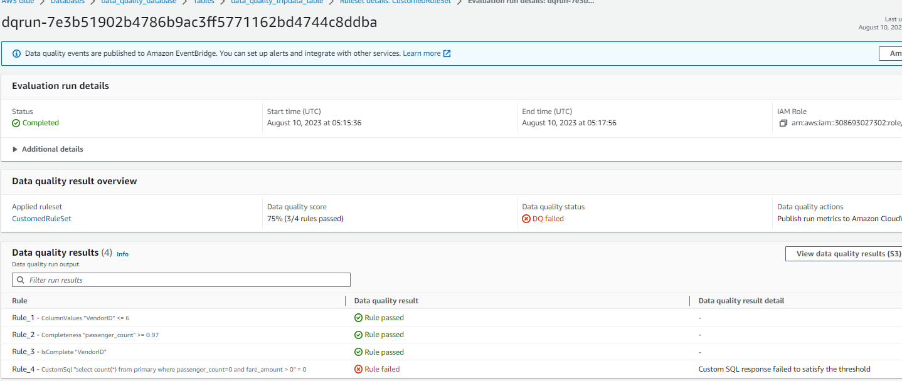
Results
- Rule 4 failed.
- Means that there are entries where there are no passenger but there are fares incurred

Slide 20
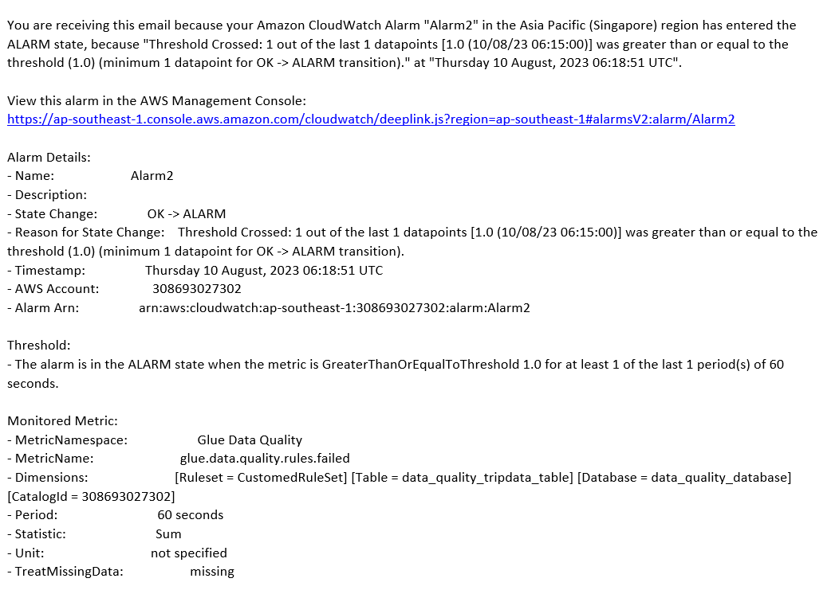
Email Alert from SNS

Slide 21
Glue DataQuality from ETL pipeline

Slide 22
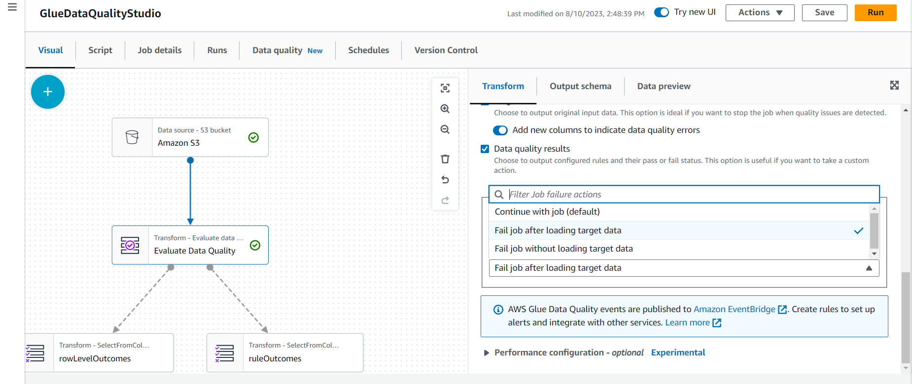
Features
Option to add new columns for data quality errors
Option to choose what happens if DataQuality Job fails

Slide 23
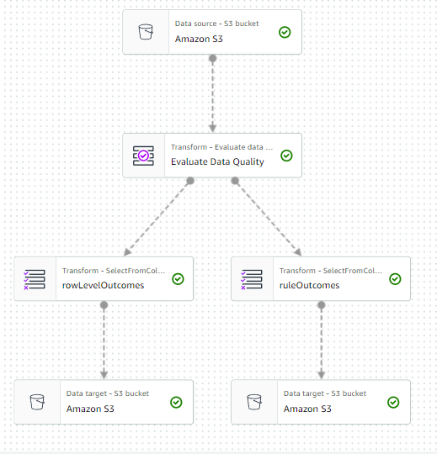
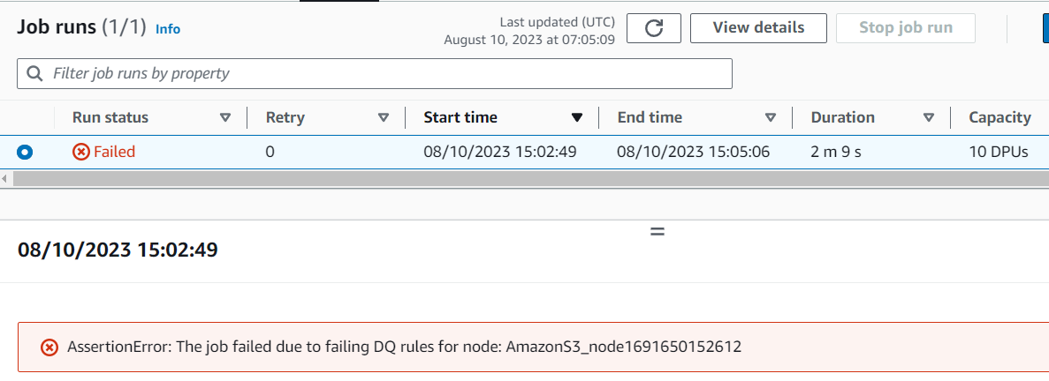
Incorporating Data at rest into Data in transit
- Creating a ‘data at rest’ DataQuality Run at the start

Slide 24
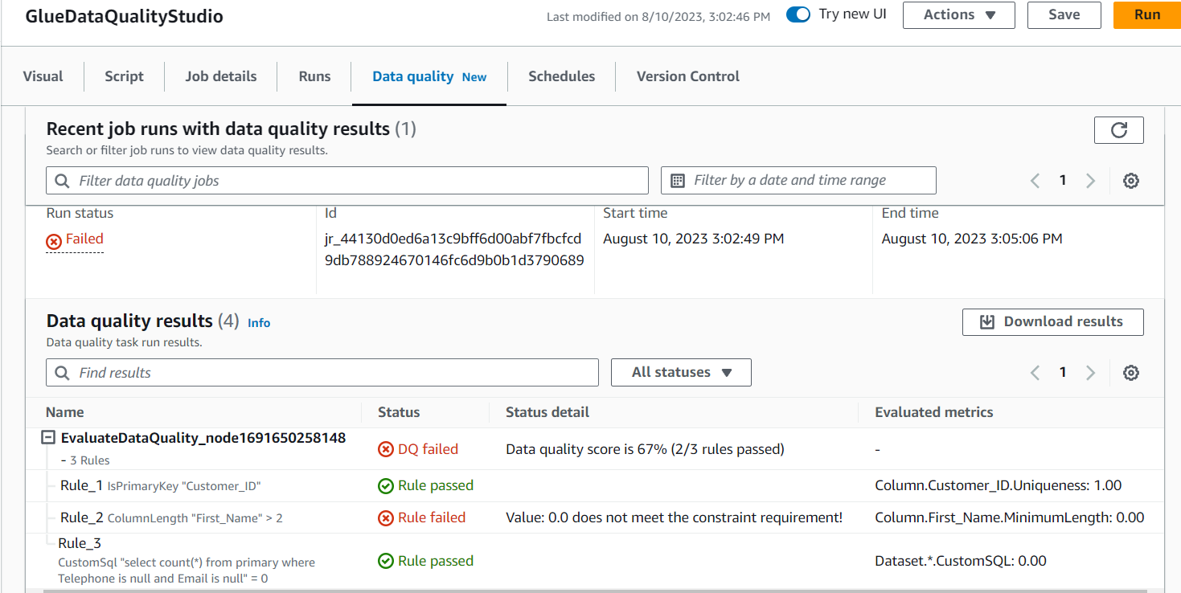

Slide 25
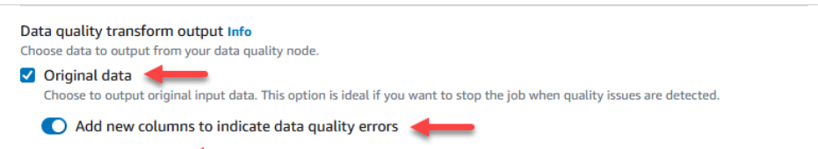
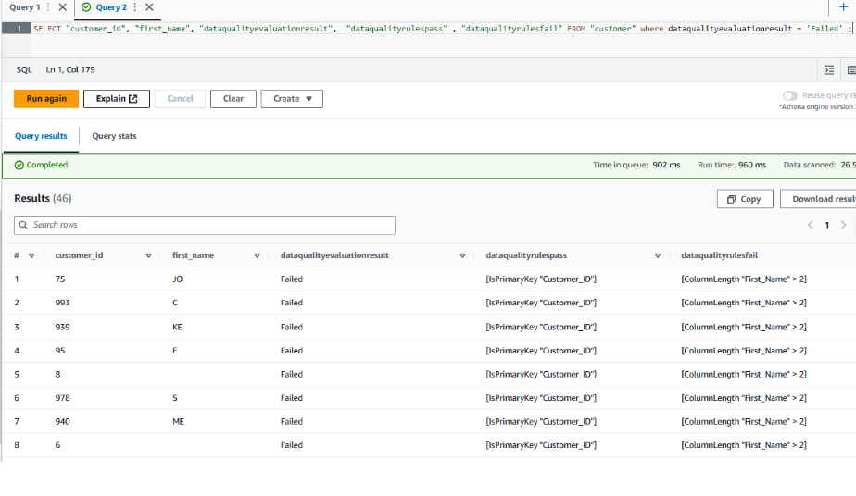
Link to Athena to check the failed rows
Output original data with new columns to indicate data quality errors
Crawl the file
View data in Athena
Query where dataqualityevaluationresult = “Failed

Slide 26
Possible use case: Validate DataQuality from Data Ingestion (Comparing 2 datasets)
Glue Job
Glue Job
Source with Multiple Datasets
(eg RDS MySQL)
DataCatalog (RDS)
DataCatalog
(S3)
DQ Run
Pass
Carry on
Can check for:
RowCountMatch
DatasetMatch
ReferentialIntegrity
AggregateMatch
SchemaMatch
Fail
Send Notification
STOP

Slide 27
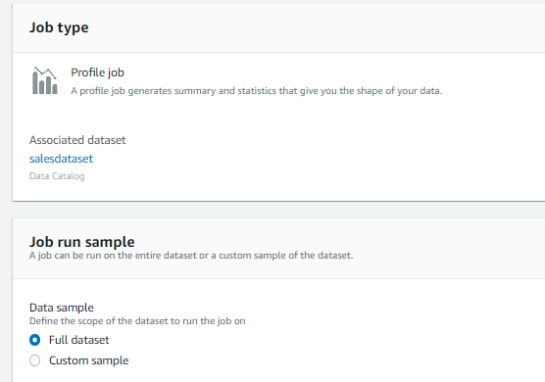
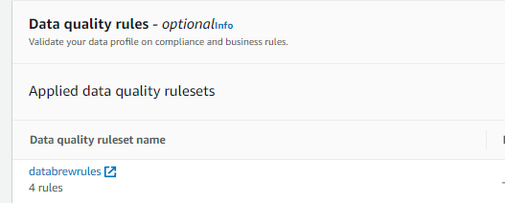
Databrew
With Data Catalog done (more for data at rest)
Create a job to run to capture data profile of dataset and set DataQuality check

Slide 28
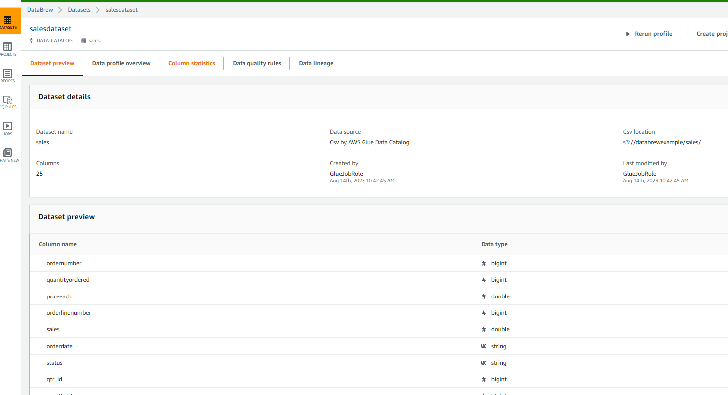
Dataset preview

Slide 29
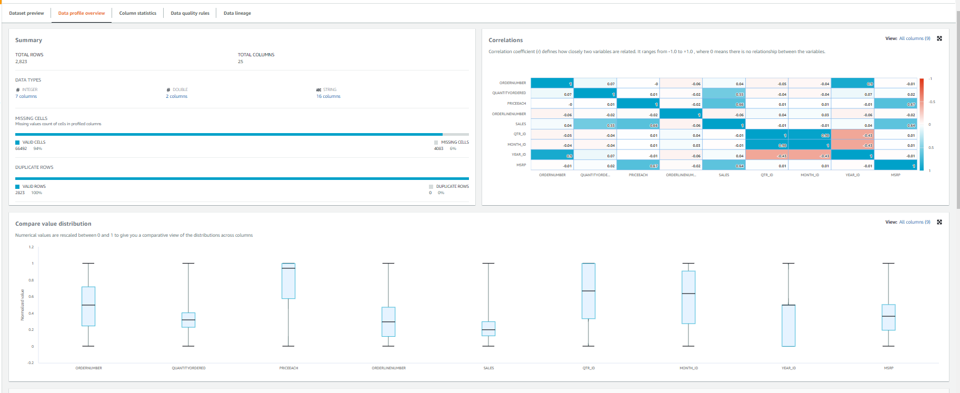
Data profile

Slide 30
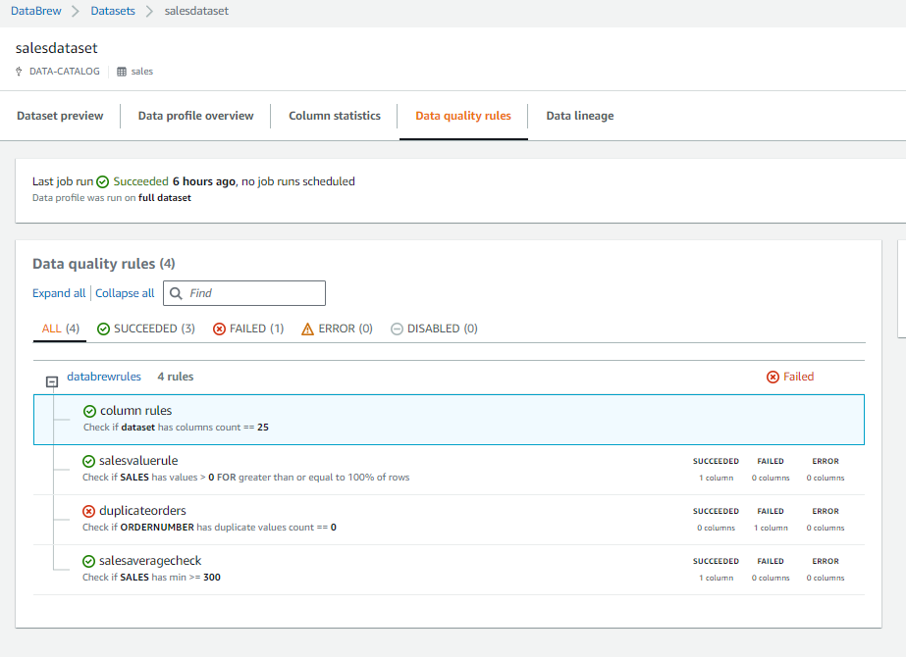
Data Quality Rules

Slide 31
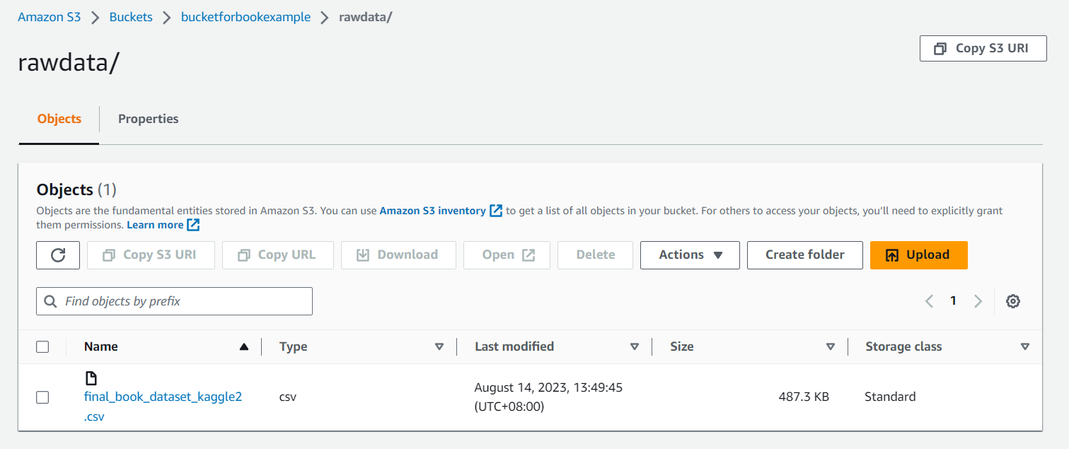
Book Example
Upload file to S3

Slide 32
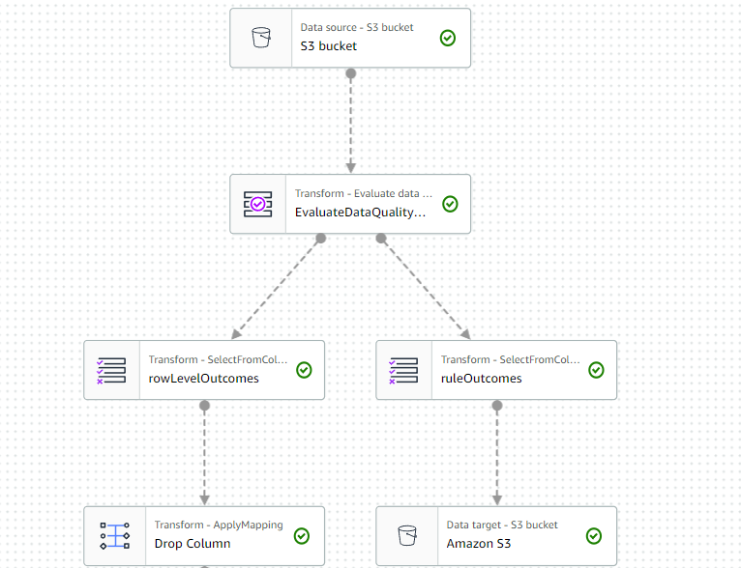
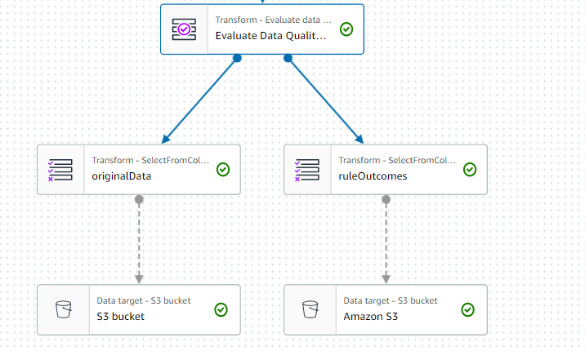
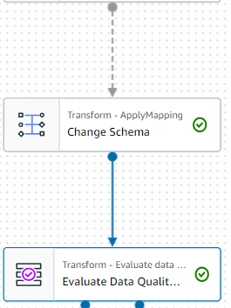
First DQ ruleset
Process Flow
Job stop if dq fails
Store ruleoutcome/firstdq
Second DQ ruleset
Transform1
Transform2
Job stop if dq fails
Store ruleoutcome/seconddq
Store output

Slide 33
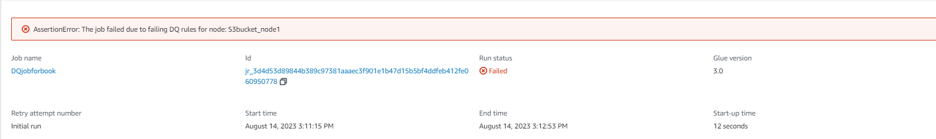
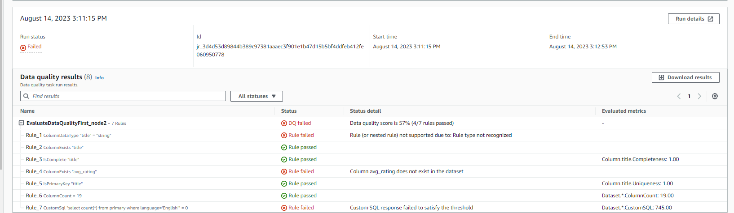
First Run

Slide 34
First DQ ruleset
Job stop if dq fails
Store ruleoutcome/firstdq
Second DQ ruleset
Transform1
Transform2
Job stop if dq fails
Store ruleoutcome/seconddq
Store output

Slide 35
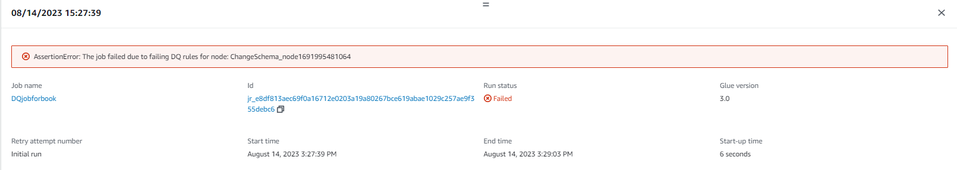
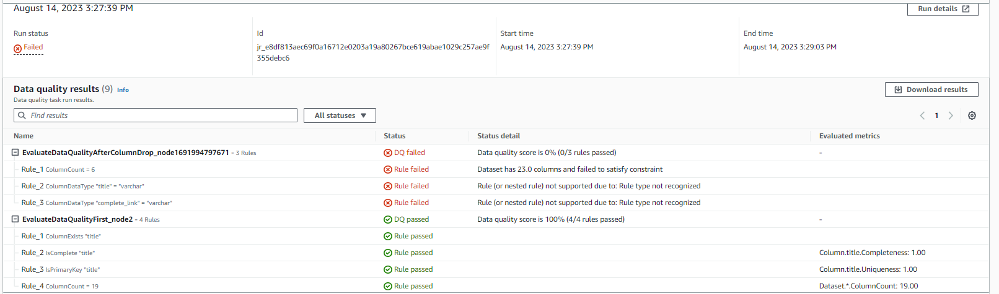
Second Run

Slide 36
First DQ ruleset
Job stop if dq fails
Store ruleoutcome/firstdq
Second DQ ruleset
Transform1
Transform2
Job stop if dq fails
Store ruleoutcome/seconddq
Store output

Slide 37
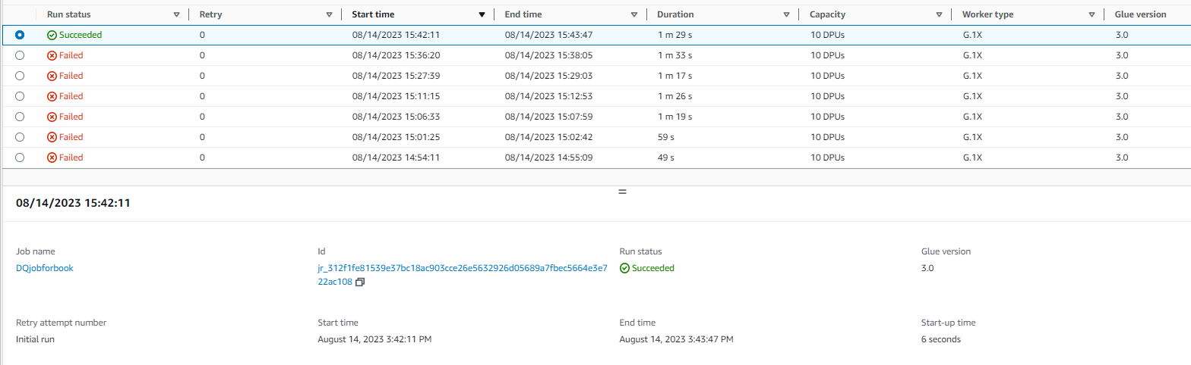
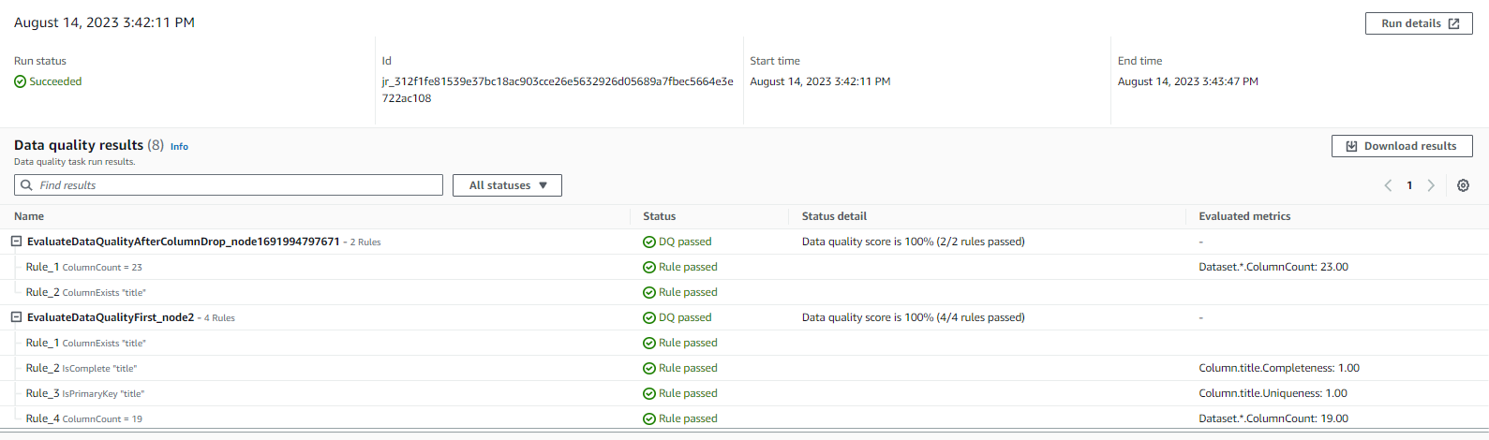
Third Run
But result was funny. Column count 23?

Slide 38
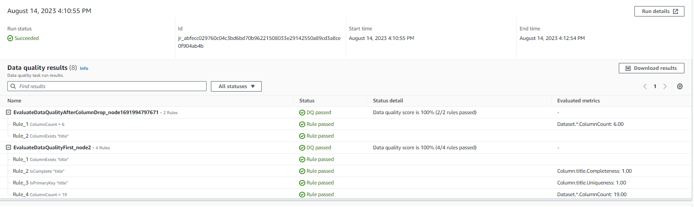
Fourth Run

Slide 39
Triggering
Step Functions, Lambda, Event Bridge
Airflow to trigger glue job with Glue DataQuality incorporated within Glue Job

Slide 40
To further explore
Incorporating Dataquality rules in existing gluejob in code.

